Slide 1

ADRANK

Slide 2
CONTENT
Abstract
Problem
Solution
Advantages
Screenshots
Challenges
Future Work

Slide 3
ABSTRACT
Our web application enables users to have a secure user account with us. It allows users to search video online along with various information like title, category, number of views, author and so on.
This application also displays the most recent searches and maintains a list of popular videos.
User Authentication is provided to offer security and privacy to user data.

Slide 4
PROBLEM
Creating a login page with email address and pre-assigned password. It also requires two option “Remember me” and “Forgot Password.”
It also have a sign up page that enables a new user to create an account.
A search page that retrieves and returns most relevant videos along with the metadata to user’s search.
A dashboard that shows most recent searches.
Another page that displays most recent logged on users.

Slide 5
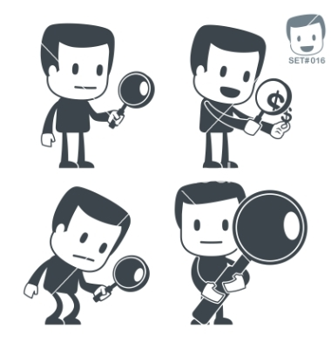
SOLUTION
AdRank is an effective solution to this problem.
Image Courtesy: http://www.vectorstock.com/

Slide 6
ADAVANTAGES
“You are Just a Click Away to The Desired Result.”
AdRank offers services to have easy search.
It saves time and improves relevancy to user’s search.
User authentication and security to user’s information are another great advantages of this application.

Slide 7
Sign in/Sign up page

Slide 8
Search page

Slide 9
Keyword search analytics
User information

Slide 11
CHALLENGES
Zero familiarity with You Tube V3 API.
No real time knowledge of IBM BlueMix.
Very Little Knowledge of NOSQL Database.
Time Limit was the biggest challenge.

Slide 12
FUTURE WORK
Adding more options to searching and sorting.
Setting the videos as favorite.
Providing more security to user’s activity.
Implementing more unique ideas to improve usability.

